Slide 1
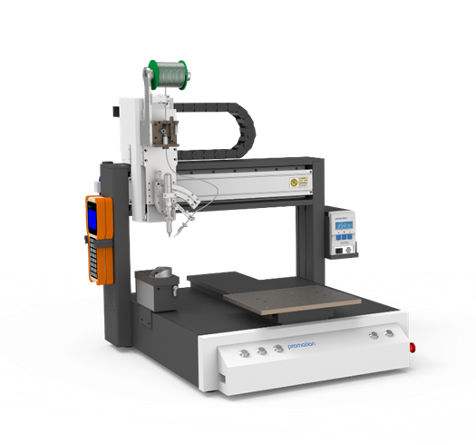
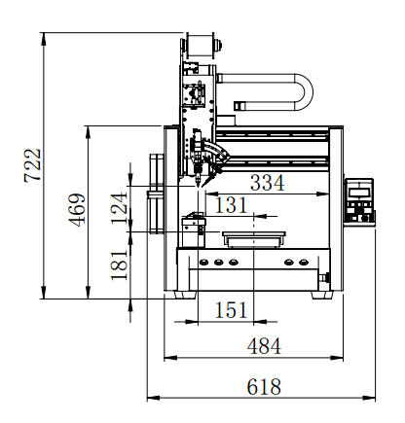
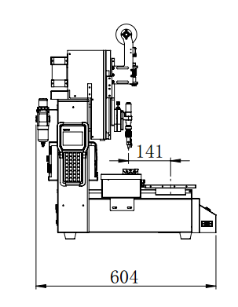
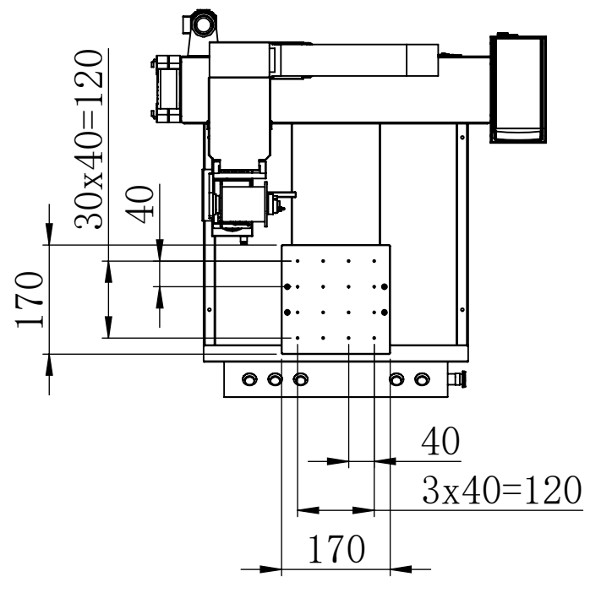
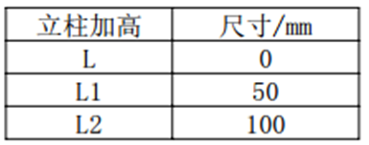
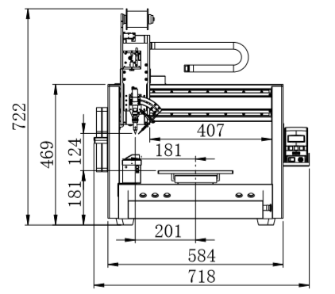
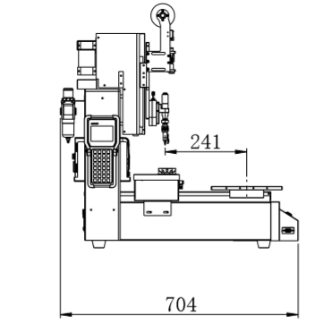
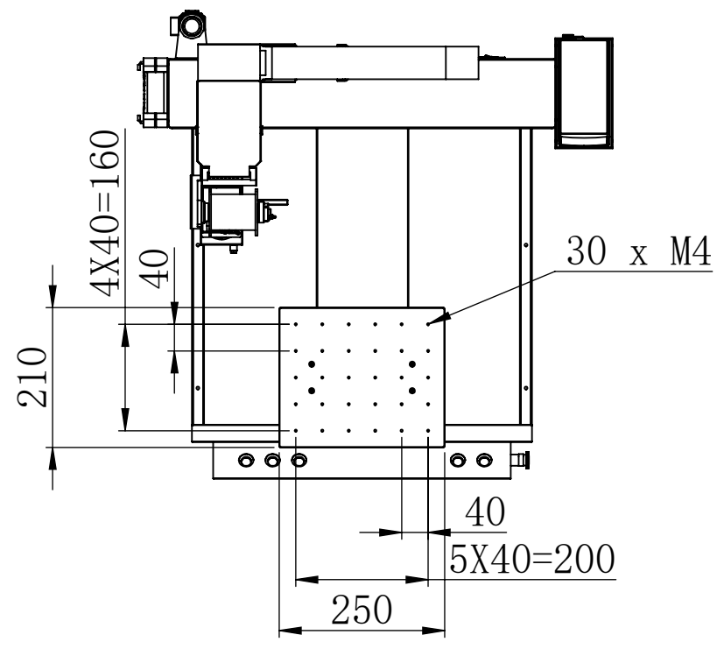
Features
ET9383C/9483C
Motion Platform
ECO Series Soldering Robot with high precision built-in solder feeding module, pulse control of solder feed length and speed, real-time temperature control and independent solder feeding module provide easier maintenance. High performance soldering at an affordable price.
Heating Controller
High-power PROMATION 262 provides intelligent temperature control, features a high-frequency eddy current heating technology, double temperature display, digital temperature calibration, password control, switching power supply; resulting in a stable and reliable output.
Soldering Iron
150Watt Industrial Grade Soldering Iron, front temperature sensor, rapid sensing of solder joint
temperature fluctuation, rapid thermal recovery.
Solder Feeder
Compact high precision solder feeder, controlled by precision stepping motor, the minimum solder feeding length can reach 0.1mm. Standard features include: material outage alarm and material jam detection alarm.
Teach Pendant
Easy-to-use teaching pendant, supports: point to point programming, slide / drag soldering operations, expand step and repeat functions, array functions and group functions. Simulation modes and step by step program walk-through come standard.
Model |  | PROMATION ET9383C | PROMATION ET9483C
Number of controllable axis |  | 3 | 3
Power consumption |  | 250W | 250W
Heating controller power consumption |  | 150W | 150W
Movement range | X/Y Axis | 300mm | 400mm
 | Z Axis | 100mm | 100mm
Moving speed | X/Y Axis | 0.1～600 mm/sec | 0.1～600 mm/sec
 | Z Axis | 0.1～200 mm/sec | 0.1～200 mm/sec
Repeatable accuracy | X/Y/Z Axis | ± 0.02 mm | ± 0.02 mm
Maximum payload | Z axis | 2kg | 2kg
 | Platform | 5kg | 5kg
Operating range |  | 240*300mm | 340*400mm
Size（W*D*H） |  | 620x605x720mm | 720x705x720mm
Weight |  | 40kg | 45kg
ET9383C Size
Maximum working range: 240*300mm
ET9483C Size
Maximum working range: 340*400mm
www.promationusa.com

Slide 2
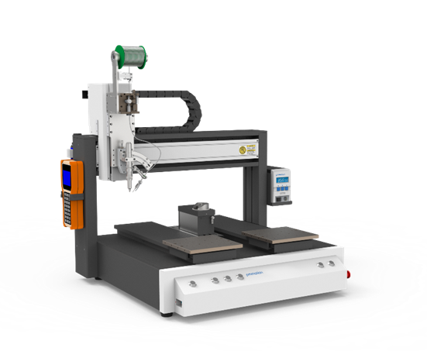
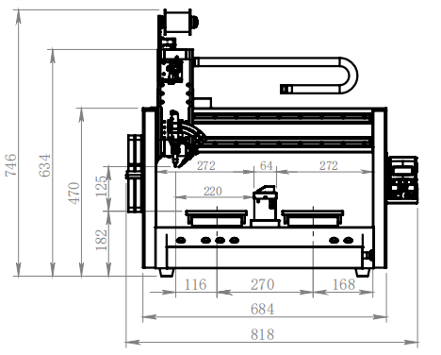
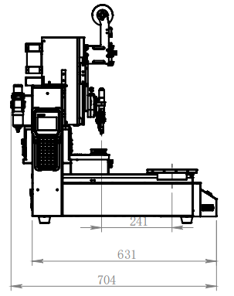
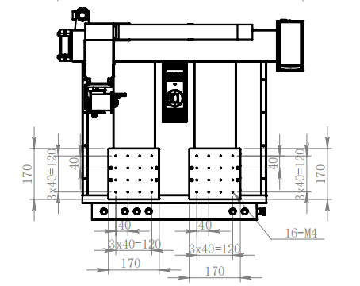
Features
ET9583CYA
Motion Platform
ECO Series Soldering Robot with high precision built-in solder feeding module, pulse control of solder feed length and speed, real-time temperature control and independent solder feeding module provide easier maintenance. High performance soldering at an affordable price.
.
Heating Controller
High-power PROMATION 262 provides intelligent temperature control, features a high-frequency eddy current heating technology, double temperature display, digital temperature calibration, password control, switching power supply; resulting in a stable and reliable output.
Soldering Iron
150Watt Industrial Grade Soldering Iron, front temperature sensor, rapid sensing of solder joint
temperature fluctuation, rapid thermal recovery.
Solder Feeder
Compact high precision solder feeder, controlled by precision stepping motor, the minimum solder feeding length can reach 0.1mm. Standard features include: material outage alarm and material jam detection alarm.
Teach Pendant
Easy-to-use teaching pendant, supports: point to point programming, slide / drag soldering operations, expand step and repeat functions, array functions and group functions. Simulation modes and step by step program walk-through come standard.
Model |  | PROMATION ET9583CYA
Number of controllable axis |  | 3
Power consumption |  | 260W
Heating controller power consumption |  | 150W
Movement range | X/Y Axis | 500mm/400mm
 | Z Axis | 100mm
Moving speed | X/Y Axis | 0.1～600 mm/sec
 | Z Axis | 0.1～200 mm/sec
Repeatable accuracy | X/Y/Z Axis | ± 0.02 mm
Maximum payload | Z Axis | 2kg
 | Platform | 5kg
Operating range |  | 230*400mm（Double Y axis）
Size（W*D*H） |  | 820x705x720mm
Weight |  | 60kg
Size
Maximum working range: 230*400mm (Double Y Axes)

Slide 3
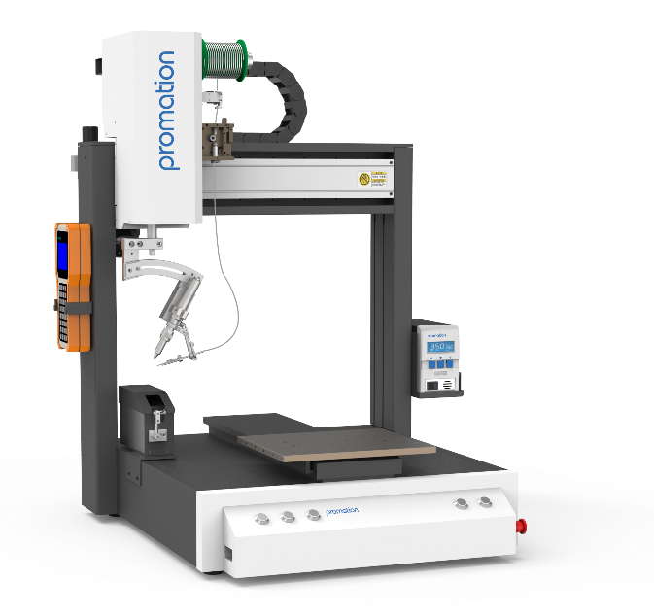
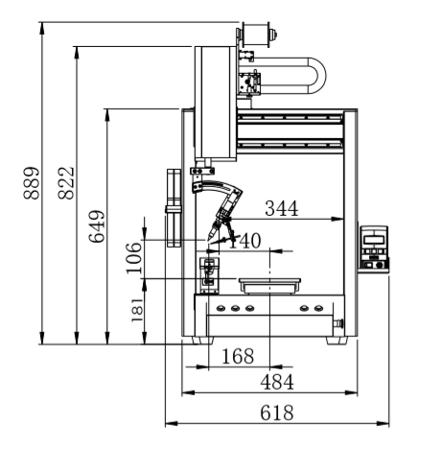
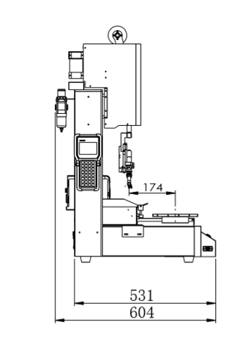
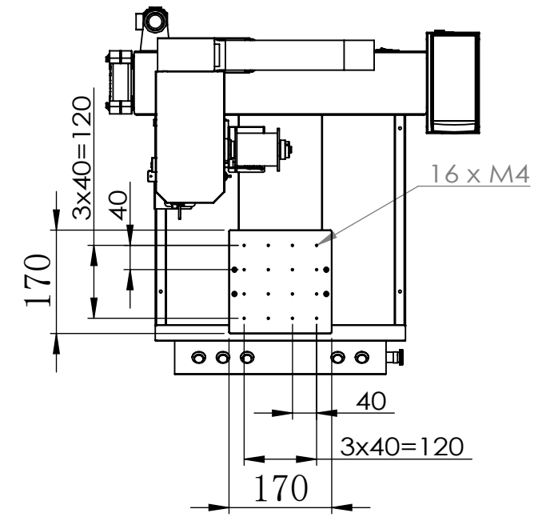
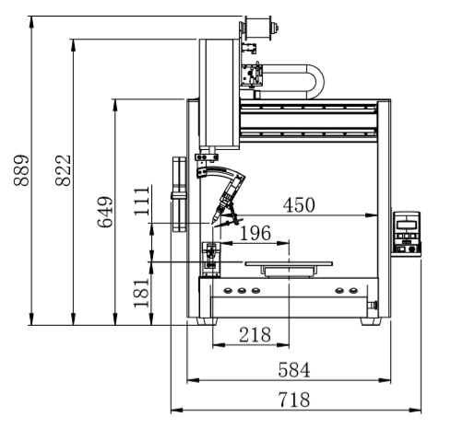
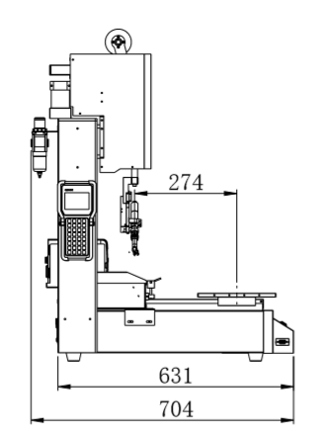
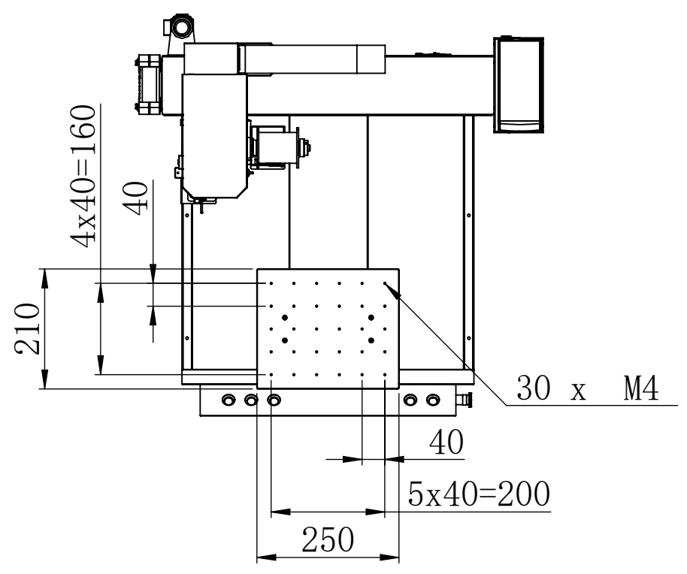
Features
ET9384C/9484C
Motion Platform
ECO Series Soldering Robot with high precision built-in solder feeding module, pulse control of solder feed length and speed, real-time temperature control and independent solder feeding module provide easier maintenance. High performance soldering at an affordable price.
.
Heating Controller
High-power PROMATION 262 provides intelligent temperature control, features a high-frequency eddy current heating technology, double temperature display, digital temperature calibration, password control, switching power supply; resulting in a stable and reliable output.
Soldering Iron
150Watt Industrial Grade Soldering Iron, front temperature sensor, rapid sensing of solder joint temperature fluctuation, rapid thermal recovery.
Solder Feeder
Compact high precision solder feeder, controlled by precision stepping motor, the minimum solder feeding length can reach 0.1mm. Standard features include: material outage alarm and material jam detection alarm.
Teach Pendant
Easy-to-use teaching pendant, supports: point to point programming, slide / drag soldering operations, expand step and repeat functions, array functions and group functions. Simulation modes and step by step program walk-through come standard.
Model |  | PROMATION ET9384C | PROMATION ET9484C
Number of controllable axis |  | 4 | 4
Power consumption |  | 280W | 280W
Heating controller power consumption |  | 150W | 150W
Movement range | X/Y Axis | 300mm | 400mm
 | Z Axis | 100mm | 100mm
 | R Axis | 300° | 300°
Moving speed | X/Y Axis | 0.1～600 mm/sec | 0.1～600 mm/sec
 | Z Axis | 0.1～200 mm/sec | 0.1～200 mm/sec
 | R Axis | 0.1-600°/sec | 0.1-600°/sec
Repeatable accuracy | X/Y/Z Axis | ± 0.02 mm | ± 0.02 mm
 | R Axis | ±0.02° | ±0.02°
Maximum payload | Z Axis | 2kg | 2kg
 | Platform | 5kg | 5kg
Operating range |  | 240*300mm | 340*400mm
Size（W*D*H） |  | 620x605x720mm | 720x705x890mm
Weight |  | 45kg | 55kg
ET9384C Size
Maximum working range: 240*300mm
ET9484C Size
Maximum working range: 340*400mm

Slide 4
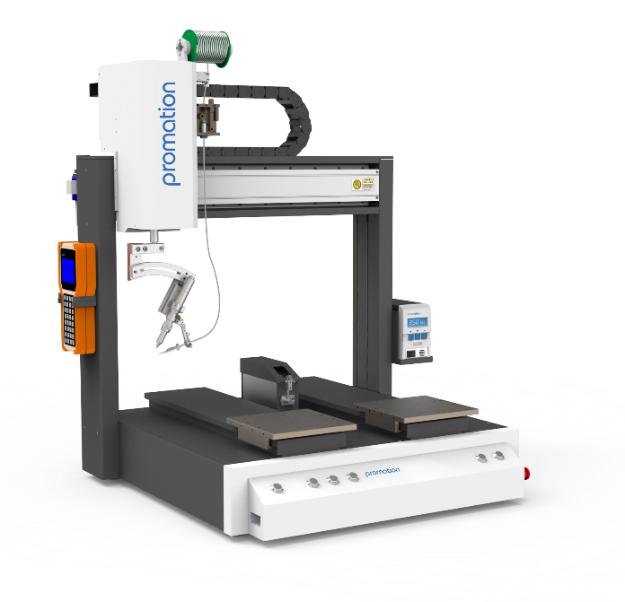
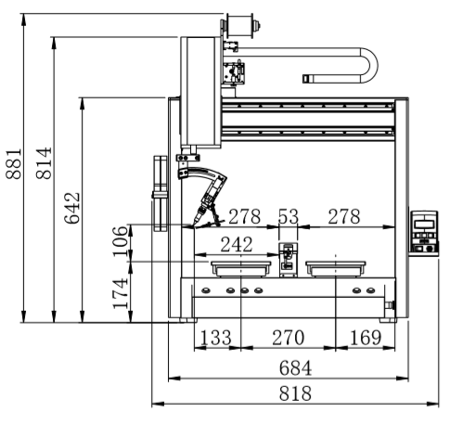
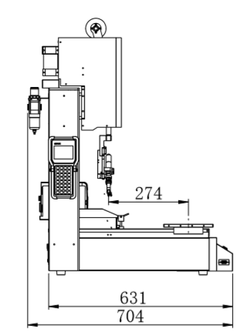
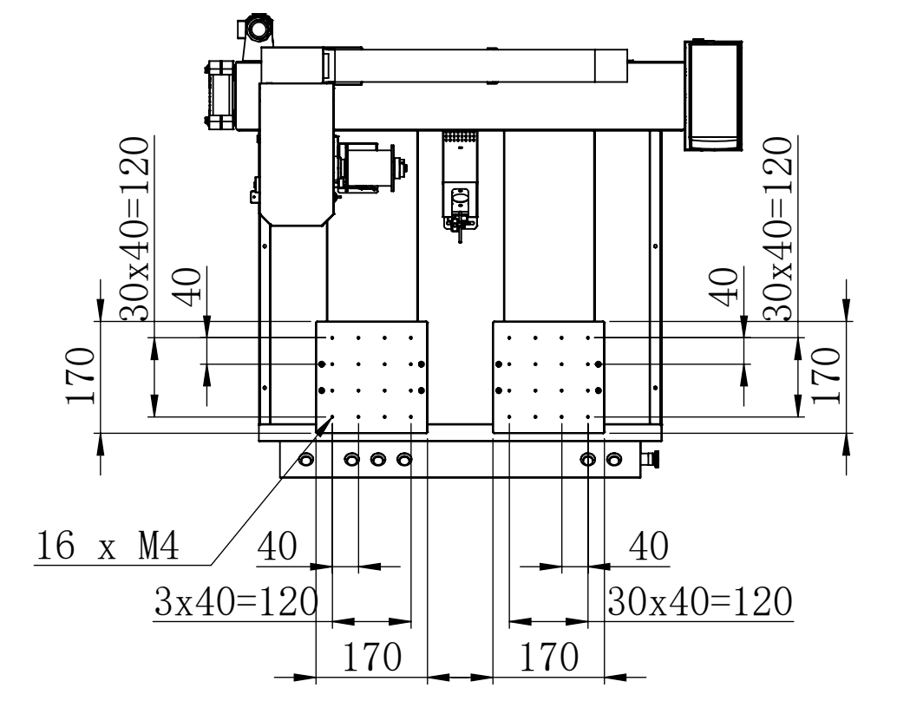
ET9584CYA
Features
Motion Platform
ECO Series Soldering Robot with high precision built-in solder feeding module, pulse control of solder feed length and speed, real-time temperature control and independent solder feeding module provide easier maintenance. High performance soldering at an affordable price.
Heating Controller
High-power PROMATION 262 provides intelligent temperature control, features a high-frequency eddy current heating technology, double temperature display, digital temperature calibration, password control, switching power supply; resulting in a stable and reliable output.
Soldering Iron 150Watt Industrial Grade Soldering Iron, front temperature sensor, rapid sensing of solder joint temperature fluctuation, rapid thermal recovery.
Solder Feeder
Compact high precision solder feeder, controlled by precision stepping motor, the minimum solder feeding length can reach 0.1mm. Standard features include: material outage alarm and material jam detection alarm.
Teach Pendant
Easy-to-use teaching pendant, supports: point to point programming, slide / drag soldering operations, expand step and repeat functions, array functions and group functions. Simulation modes and step by step program walk-through come standard.
Model |  | PROMATION ET9584CYA
Number of controllable axis |  | 4
Power consumption |  | 310W
Heating controller power consumption |  | 150W
Movement range | X/Y Axis | 500mm/400mm
 | Z Axis | 100mm
 | R Axis | 300°
Moving speed | X/Y Axis | 0.1～600 mm/sec
 | Z Axis | 0.1～200 mm/sec
 | R Axis | 0.1～600°/sec
Repeatable accuracy | X/Y/Z Axis | ± 0.02 mm
 | R Axis | ±0.02°
Maximum payload weight | Z Axis | 2kg
 | Platform | 5kg
Operating range |  | 230*400mm（Double Y axes）
Size（W*D*H） |  | 820x705x880mm
Weight |  | 65kg
Size
Maximum working range: 230*400mm (Double Y Axes)

Slide 5
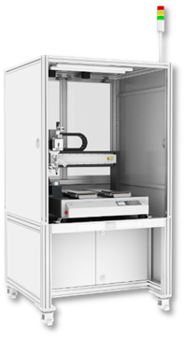
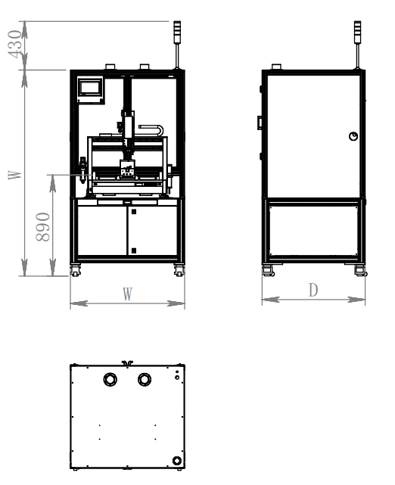
ESC40AB Enclosure
Features
ESC40AB Safety Enclosure
Fits all ECO Series Soldering Robot Models.
Improve Safety
Improve Operator Safety with a Floor Standing Safety Enclosure
Easy Set-Up & Installation Easy Set-Up and Installation, as the robot comes preinstalled in the safety enclosure. Simply remove the unit from the crate and into
Elegant Appearance
Add a sophisticated appearance to your manufacturing equipment and production line with the upgraded safety enclosure package. The Interior LED Light Kit will illuminate the work cell; allowing for improved visibility during operation and set-up.
Lower Locking Cabinets
Lower Locking Cabinet draws add improved human ergonomics and a local secured storage space for materials and spare parts.
Specification Table:
Work Model | Working Table-Top Size |  |  | Maximum Stroke of Applicable Equipment |  | Model(s)
 | Width (W) | Deep (D) | High (H) | X | Y
ESC40AB | 1000mm | 900mm | 1800mm | 500mm | 400mm | ECO SERIES
 |  |  |  |  |  | ECO SERIES
ESC40AC | 900mm | 900mm | 1800mm | 400mm | 400mm | E SERIES
 |  |  |  | 400mm | 400mm | F SERIES
 |  |  |  | 400mm | 400mm | E + F SERIES
 |  |  |  | 300mm | 300mm | E + F SERIES
Dimensions:

